Slide 1
Project 2: Implementation of Dijkstra algorithm for a Point Robot
This is an Individual project.
Due Date – March 5th, 11.59 PM

Slide 2
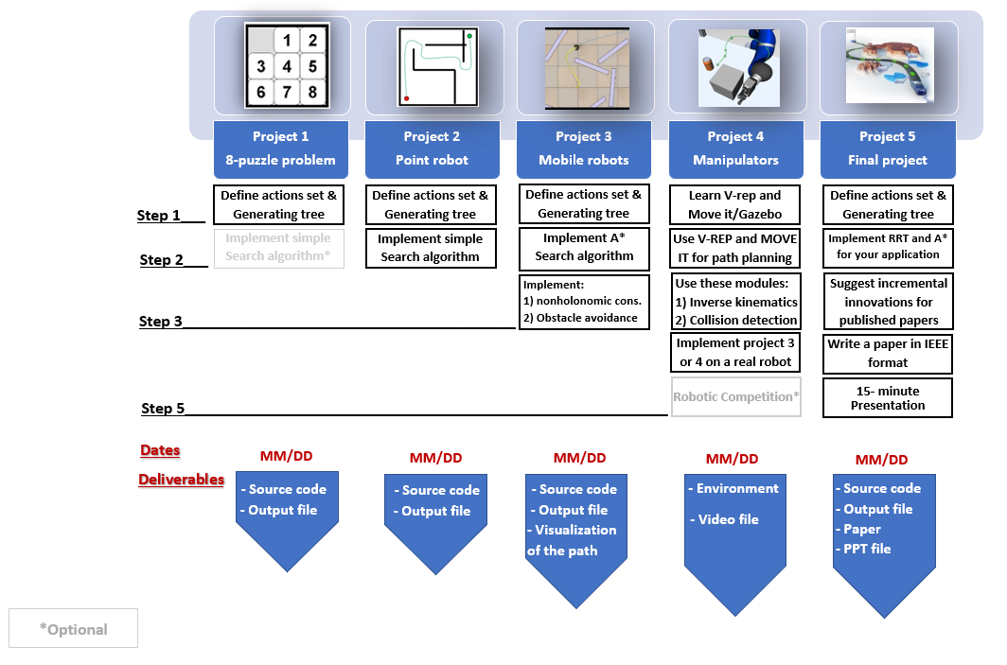
Implement Dijkstra search algorithm
queue

Slide 3
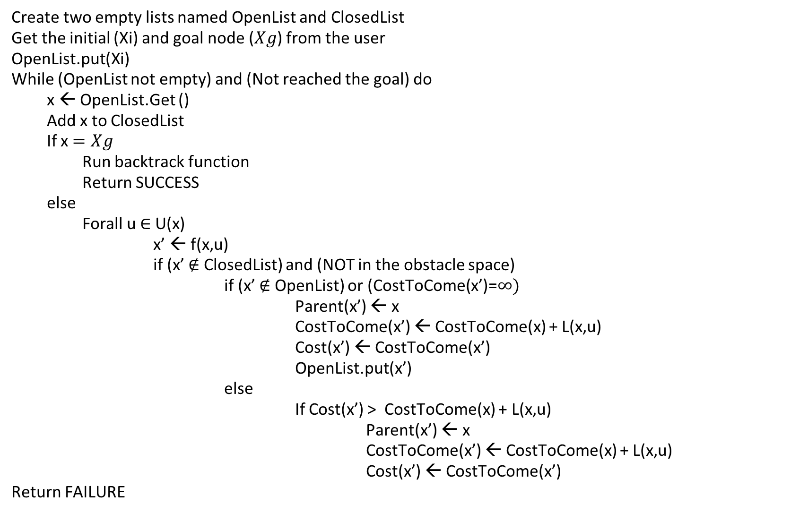
Dijkstra algorithm - pseudo code
Create two empty lists named OpenList and ClosedList
Get the initial (Xi) and goal node ($Xg$) from the user
OpenList.put(Xi)
While (OpenList not empty) and (Not reached the goal) do
x ← OpenList.Get ()
Add x to ClosedList
If x $=Xg$
Run backtrack function
Return SUCCESS
else
Forall u $∈$ U(x)
x’ ← f(x,u)
if (x’ $∉$ ClosedList) and (NOT in the obstacle space)
if (x’ $∉$ OpenList) or (CostToCome(x’)=$∞)$
Parent(x’) ← x
CostToCome(x’) ← CostToCome(x) + L(x,u)
Cost(x’) ← CostToCome(x’)
OpenList.put(x’)
else
If Cost(x’) > CostToCome(x) + L(x,u)
Parent(x’) ← x
CostToCome(x’) ← CostToCome(x) + L(x,u)
Cost(x’) ← CostToCome(x’)
Return FAILURE

Slide 4
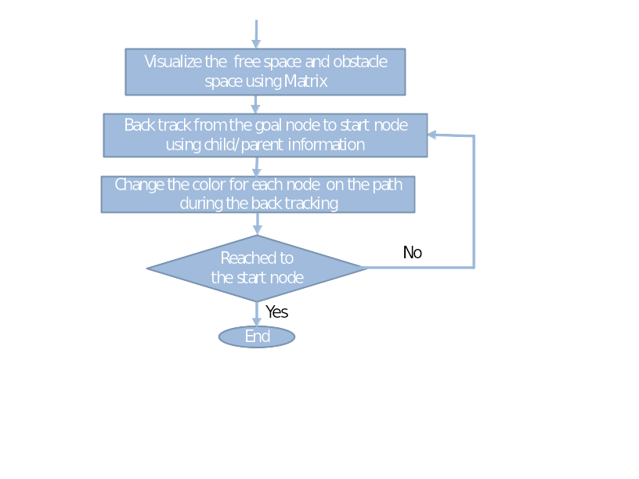
Start
Project 2- Dijkstra algorithm
Get the initial and goal node from the user
Define the obstacle space by mathematical equations
Create a matrix to store C2C for nodes, set -1 for obstacle nodes and ∞ for free space nodes
Define the action set by mathematical equations
Create a two lists (Open and Closed) and append the initial node to the Open list
No solution found
Yes
Pop a new node with lowest C2C from the Open list
Open list empty
No
Add the popped node to the Closed list
Visualize the shortest path
yes
Node is the goal node
yes
Last action
Back track to find the optimal path
No
Perform actions from action set to generate new nodes
Node is in the obstacle space
Yes
No
Node is in the closed list
Yes
Yes
No
Calculate new C2C
New C2C > previous C2C
No
Update the parent node
Update the C2C for the node

Slide 5
Or
Start
Project 2- Dijkstra algorithm
Get the initial and goal node from the user
Define the obstacle space by mathematical equations
Define the action set by mathematical equations
Create a two lists (Open and Closed) and append the initial node to the Open list
No solution found
Yes
Pop a new node with lowest C2C from the Open list
Open list empty
No
Add the popped node to the Closed list
Visualize the shortest path
yes
Node is the goal node
yes
Back track to find the optimal path
Last action
No
Perform actions from action set to generate new nodes
Node is in the obstacle space
Yes
Calculate new C2C &
store the parent node &
add the node to open list
No
Node is in the closed list
No
No
Node in the open list
Yes
Previous C2C > New C2C
Yes
Update the parent node
Update the C2C for the node

Slide 6
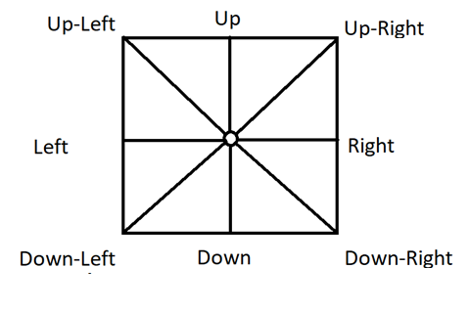
Project 2 Description
Cost=1.4
Cost=1
Cost=1.4
Project Assumption: Workspace is an 8 connected space, that means now you can move the robot in up, down, left, right & diagonally between up-left, up-right, down-left and down-right directions.
Action sets= {(1,0), (-1,0), (0,1), (0,-1), (1,1), (-1,1),(1,-1),(-1,-1)}
Cost=1
Cost=1
Cost=1.4
Cost=1
Cost=1.4

Slide 7
Project 2 Description
1) Check the feasibility of all inputs/outputs (if user gives start and goal nodes that are in the obstacle space they should be informed by a message and they should try again).
2) Implement Dijkstra’s Algorithm to find a path between start and end point on a given map for a point robot (radius = 0; clearance = 5 mm).
3) Your code must output an animation of optimal path generation between start and goal point on the map. You need to show both the node exploration as well as the optimal path generated. (Some useful tools for simulation are OpenCV/Pygame/Matplotlib).

Slide 8
Visualization
https://drive.google.com/file/d/1OTvRGCmQ35oXbf5HEe70rL6czHS3PJf5/view

Slide 9
Step 1) Define the actions in a mathematical format
Use can use the same data structure from project 1 to store the node information.
Write 8 subfunctions, one for each action. The output of each subfunction is the state of a new node after taking the associated action.
Action sets= {(1,0), (-1,0), (0,1), (0,-1), (1,1), (-1,1),(1,-1),(-1,-1)}

Slide 10
Step 2) Find mathematical representation of free space
Use Half planes and semi-algebraic models to represent the obstacle space.

Slide 11
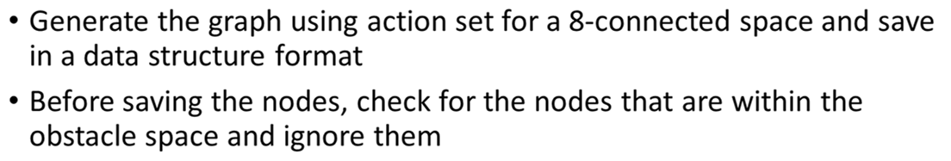
Step 3) Generate the graph and check for the goal node in each iteration

Slide 12
Step 4) Find the optimal path (Backtracking)
Once the goal node is popped, stop the search and back track to find the path
Steps:
Write a subfunction that compares the current node with the goal node and return TRUE if they are equal.
While generating each new node this subfunction should be called
Write a subfunction that once the goal node is reached, using the child and parent relationship, it backtracks from the goal node to initial node and outputs all the intermediate nodes.

Slide 13
Step 5) Represent the optimal path
Show optimal path generation animation between start and goal point using a simple graphical interface. You need to show both the node exploration as well as the optimal path generated.
The visualization of (exploration and optimal path) should start only after the exploration is complete and optimal path is found.
Note: A separate document is provided to describe this step

Slide 14
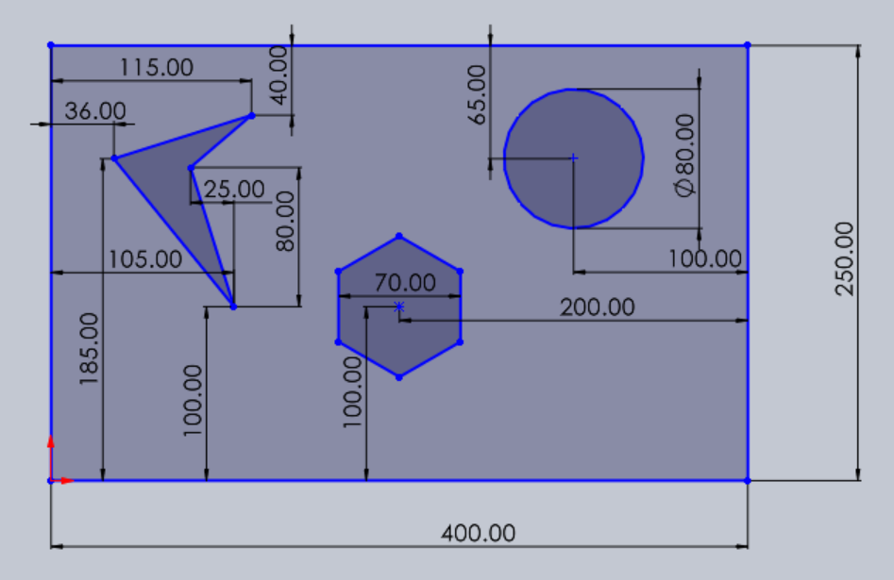
Final Map
Origin
y
x

Slide 15
Deliverables
Deliverables:
ReadMe.txt (Describing how to run the code in a txt format)
Source files
Dijkstra-pathplanning-StudentFirstName-StudentLastName.py
GitHub repository link in the URL submission
Video recording (start and goal point can be random)
Note: The code should accept start and goal points from the user
Note: Submit all the file as a single zip file. Name of the file should be in this format:
Project2-StudentFirstName-StudentLastName.zip

